Slide 1
It is self contained, serverless, zero-configuration and transactional
Standard library include a module “sqlite3” intended to work with database

Slide 2
Create database
import sqlite3
db=sqlite3.connect("cse.db")
print("database created")
db.commit()
db.close()

Slide 3
DB Browser for sqlite

Slide 4
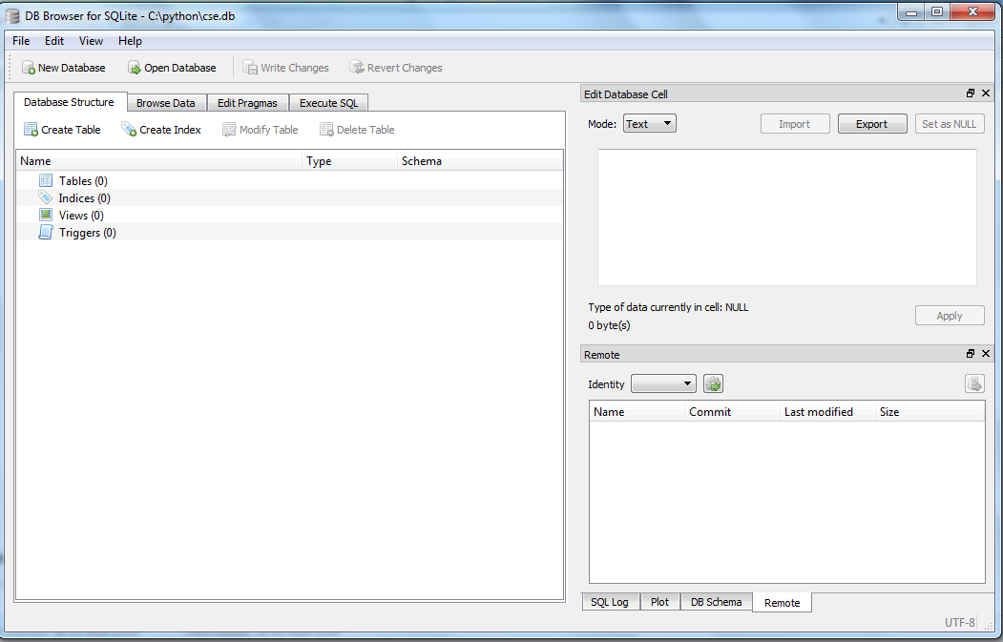

Slide 5
Create table
import sqlite3
db=sqlite3.connect("cse.db")
print("database created")
cr=db.cursor()
cr.execute("create table student(rollno integer primary key,name text)")
db.commit()
db.close()

Slide 6
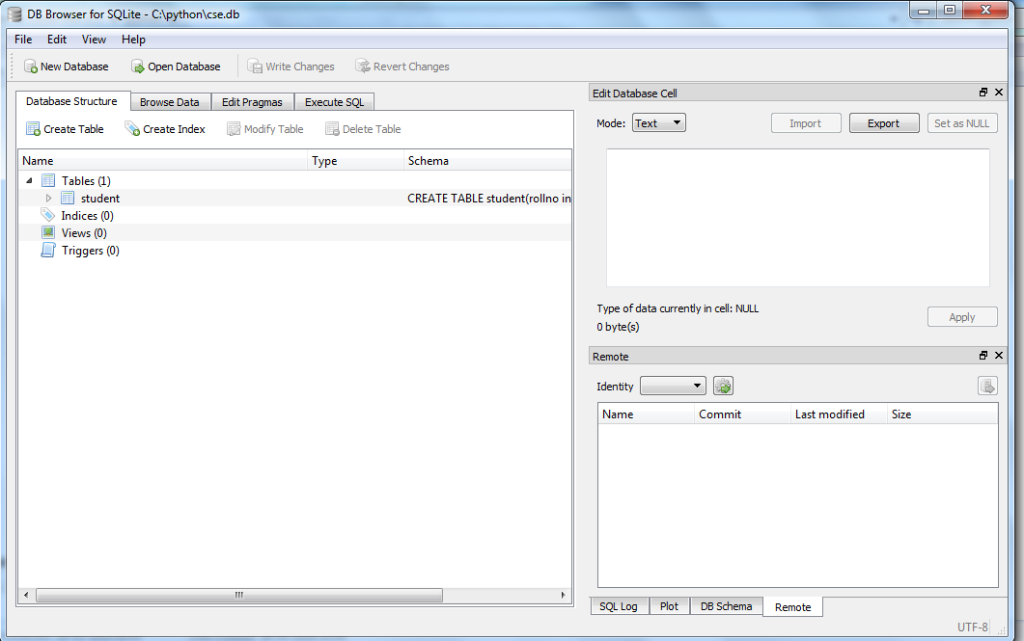

Slide 7
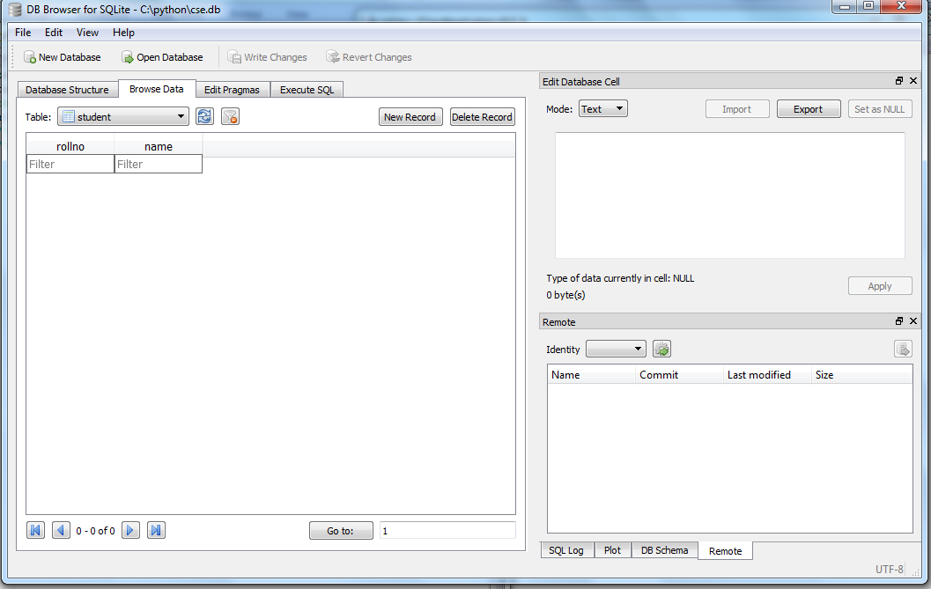

Slide 8
import sqlite3
db=sqlite3.connect("cse.db")
cr=db.cursor()
cr.execute("insert into student VALUES(1,'NEHA')")
db.commit()
db.close()

Slide 9
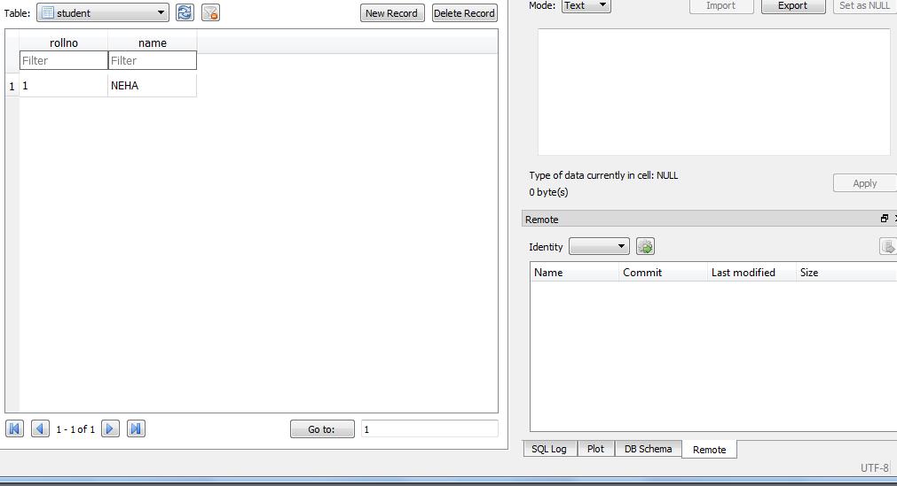

Slide 10
import sqlite3
db=sqlite3.connect("cse.db")
cr=db.cursor()
cr.execute("insert into student VALUES(1,'AMIT')")
db.commit()
db.close()

Slide 11
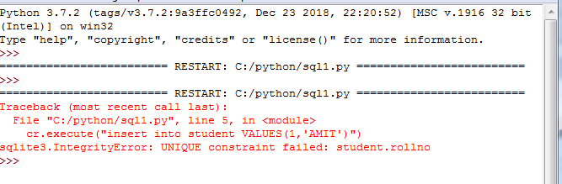

Slide 12
import sqlite3
db=sqlite3.connect("cse.db")
cr=db.cursor()
cr.execute("insert into student VALUES(2,'AMIT')")
db.commit()
db.close()

Slide 13
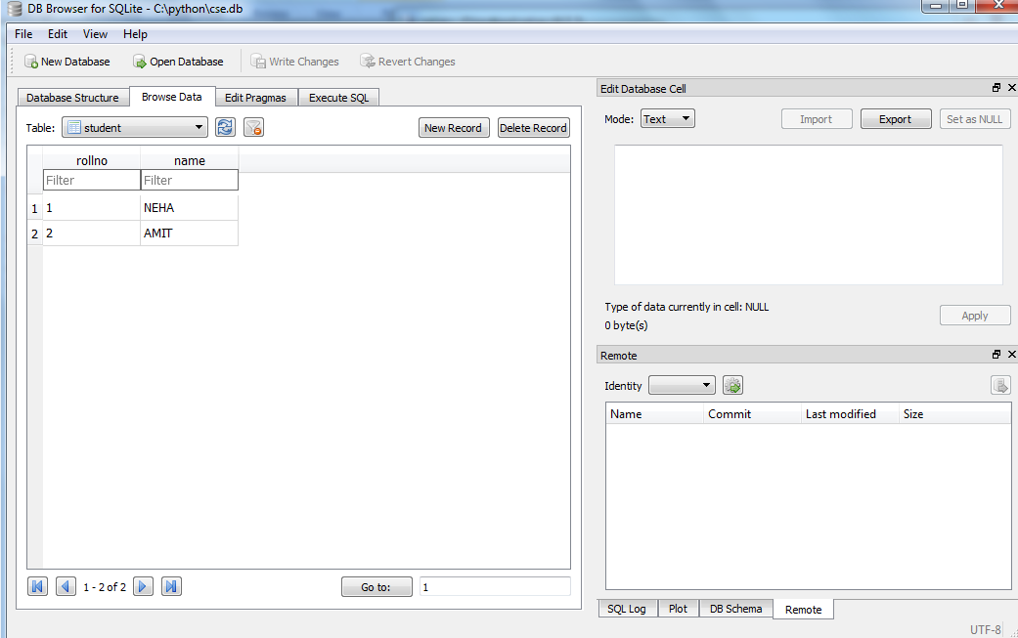

Slide 14
fetchone()
import sqlite3
db=sqlite3.connect("cse.db")
cr=db.cursor()
cr.execute("select * from student")
singler=cr.fetchone()
print(singler)
db.commit()
db.close()

Slide 15
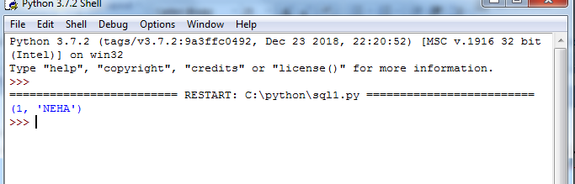

Slide 16
fetchall()
import sqlite3
db=sqlite3.connect("cse.db")
cr=db.cursor()
cr.execute("select * from student")
multir=cr.fetchall()
print(multir)
db.commit()
db.close()

Slide 17
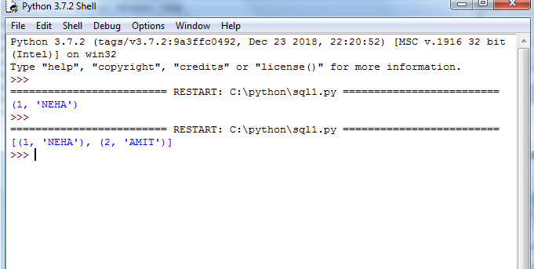

Slide 18
where clause
import sqlite3
db=sqlite3.connect("cse.db")
cr=db.cursor()
rollno=int(input())
cr.execute("select * from student where rollno=?",(rollno,))
multir=cr.fetchall()
print(multir)
db.commit()
db.close()

Slide 19
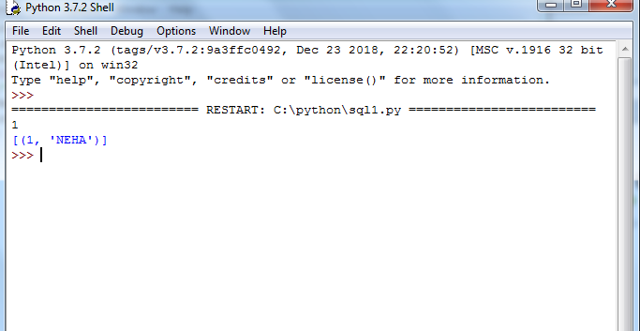

Slide 20
import sqlite3
db=sqlite3.connect("cse.db")
cr=db.cursor()
cr.execute("insert into student VALUES(3,'AMIT')")
db.commit()
db.close()
import sqlite3
db=sqlite3.connect("cse.db")
cr=db.cursor()
name=input()
cr.execute("select * from student where name=?",(name,))
multir=cr.fetchall()
print(multir)
db.commit()
db.close()

Slide 21
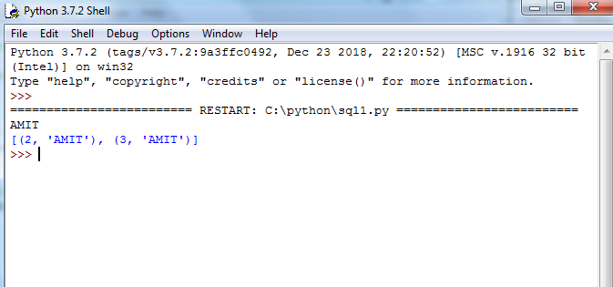

Slide 22
import sqlite3
db=sqlite3.connect("cse.db")
cr=db.cursor()
x=cr.execute("select * from student")
for row in x:
print(row)
db.commit()
db.close()

Slide 23
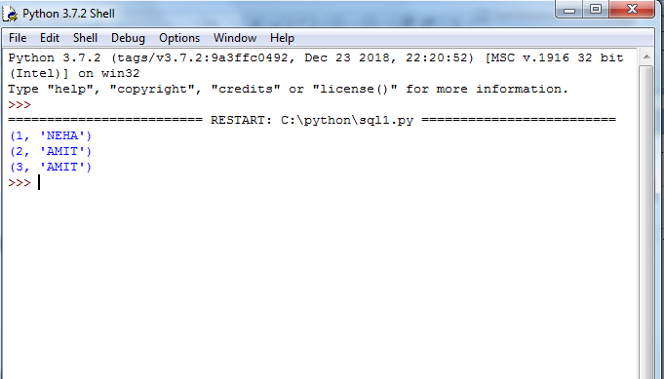

Slide 24
Delete
import sqlite3
db=sqlite3.connect("cse.db")
cr=db.cursor()
name=input()
x=cr.execute("delete from student where name=?",(name,))
for row in x:
print(row)
db.commit()
db.close()

Slide 25
import sqlite3
db=sqlite3.connect("cse.db")
cr=db.cursor()
new_rollno=1
new_name="hello"
cr.execute("update student set name=? where rollno=?",(new_name,new_rollno))
db.commit()
db.close()

Slide 26
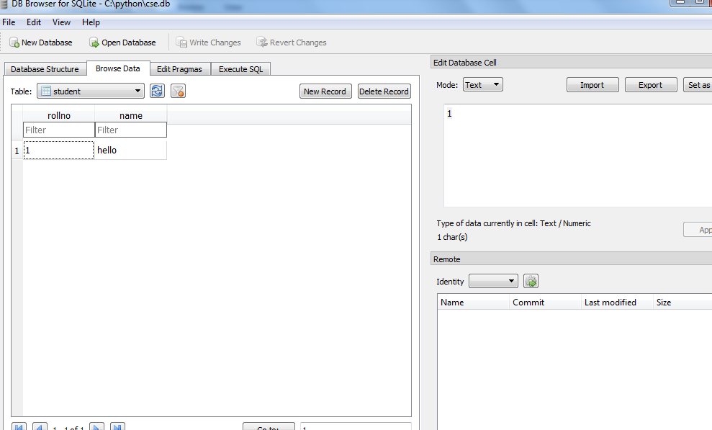

Slide 27
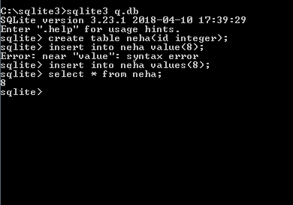

Slide 28
Select data
import sqlite3
conn = sqlite3.connect('c:\\sqlite3\\q.db')
print ("Opened database successfully")
cursor = conn.execute("SELECT id from neha")
for row in cursor:
print ("ID = ", row[0])
print( "Operation done successfully")
conn.close()

Slide 29
